Slide 1

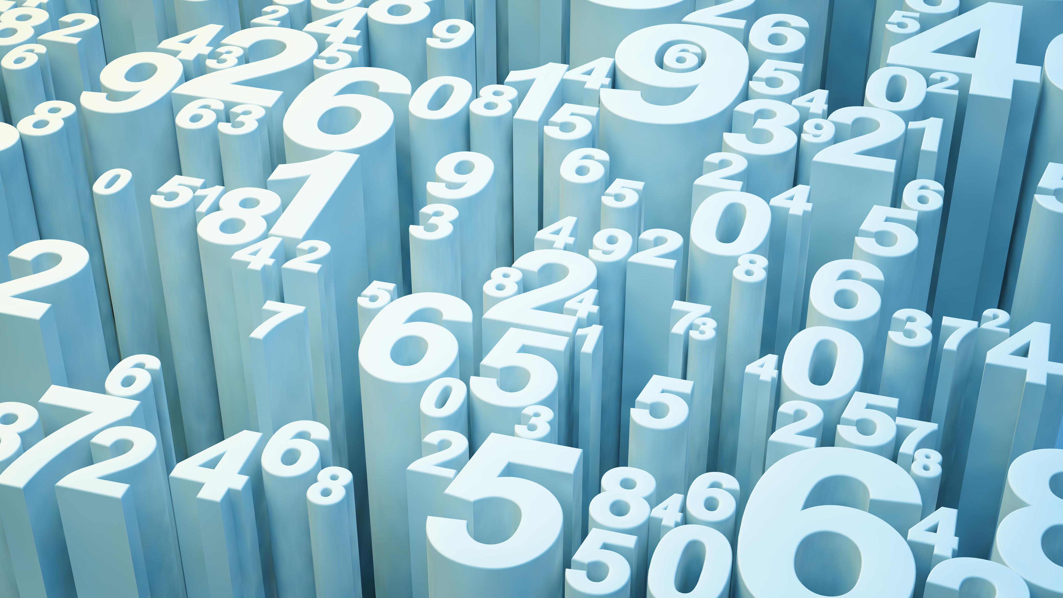
Differences Between Machine Learning & Deep Learning
Reference : https://www.datacamp.com/community/tutorials/machine-deep-learning

Slide 2


What is Artificial Intelligence?
According to the father of Artificial Intelligence, John McCarthy, it is "The science and engineering of making intelligent machines, especially intelligent computer programs".
Sit Dolor Amet

Slide 3
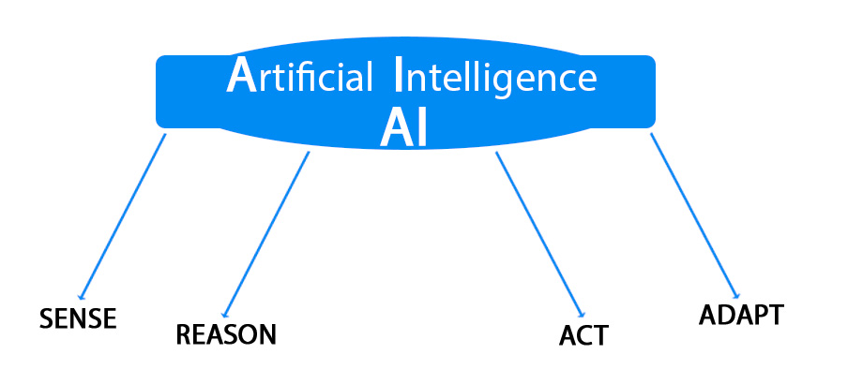

Slide 4
Machine Learning
There are various machine learning algorithms like
Decision trees,
Naive Bayes,
Random forest
Support vector machine
K-nearest neighbor,
K-means clustering,
Gaussian mixture model,
Hidden Markov model etc.

Slide 5
How will the computer learn automatically?
data
Notes:
For example: Let's say you have to predict the price of the house, given a dataset comprising of the cost of a home and the number of rooms in the house, and 1000 houses with similar attributes. Both the price and the number of rooms are features. Now your goal is to feed these two features into let's say decision trees algorithm. Your input, in this case, will be the number of rooms, and the algorithm has to predict the price of the house. The algorithm will try to learn a relationship between the number of rooms and cost of the home. Now, at test time you will give the algorithm let's say three (number of rooms) as input, and it should be able to predict the price of the house accurately!

Slide 6
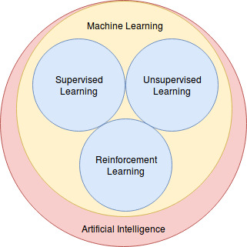
AI Coverage

Slide 7
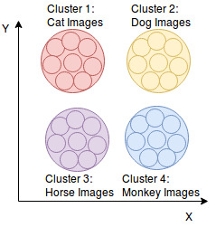
UnSupervise
Notes:
no training labelsUnsupervised Learning: Unlike supervised learning, you have no training labels for the training samples. The algorithms are formulated in such a way that they can find suitable structure and patterns in the data. Once, these consistent patterns become apparent, the similar data points can be clustered together, and different data points will be in different clusters. It is mostly used to project high-dimensional data into low-dimension for visualization or analysis purposes.

Slide 8
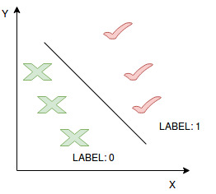
Supervised Learning

Slide 9
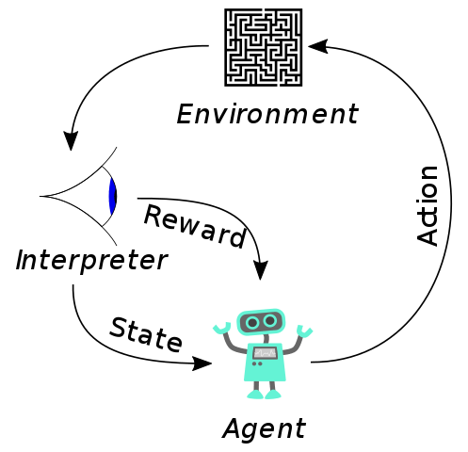
Reinforce Learning
Notes:
Reinforcement Learning: It is a type of machine learning that has an agent (like a robot) that learns how to behave in an environment by taking actions and quantifying the results. If the agent makes a correct response, it gets a reward point, which boosts up the agent's confidence to take more such actions. It works on Markov Decision Process also known as (MDP). For example: In the below figure, one can see that the agent (robot) takes action in the environment (a maze), interpreter being the eyes, it gets a reward for every correct move and depending on its current state it takes the next action.
Some cool applications of Reinforcement learning are playing games (Alpha Go, Chess, Mario), robotics, traffic light control system, etc.

Slide 10
Deep Learning by artificial neural networks and artificial neural networks commonly known as ANN

Slide 11
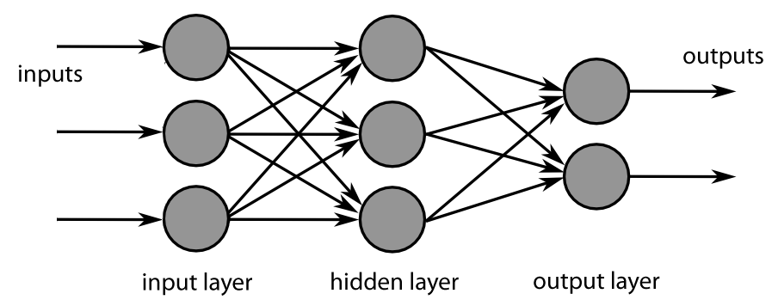
Neural Network

Slide 12
Deep Learning Methods
Some of the deep learning methods are:
Convolutional Neural Network,
Recurrent Neural Network,
Long short-term memory,
Auto Encoders
Denoising autoencoder
Stacked autoencoder
Variational autoencoder
Sparse autoencoder
Generative Adversarial network

Slide 13
Application Areas -Deep learning
Classification: whether it is a task of predicting a cat or a dog and even multi-class classification,
Feature extraction for visualizing the data in a lower dimensional space,
Data preprocessing,
Time series prediction: stock prediction, weather prediction, etc.,
Regression tasks like localization,
Object recognition which is both a classification & a regression task,
Robotics.

Slide 14

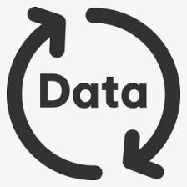


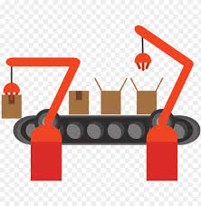



Comparison between Deep Learning & Machine Learning
Functioning
Data Dependency
Feature Extractor
Industry Ready
Computation Power
Training and Inference Time
Output
Problem-solving technique
Notes:
Machine learning uses algorithms to parse data, learn from that data, and make informed decisions based on what it has learned
Deep learning structures algorithms in layers to create an "artificial neural network” that can learn and make intelligent decisions on its own
Deep learning is a subfield of machine learning. While both fall under the broad category of artificial intelligence, deep learning is what powers the most human-like artificial intelligence

Slide 15

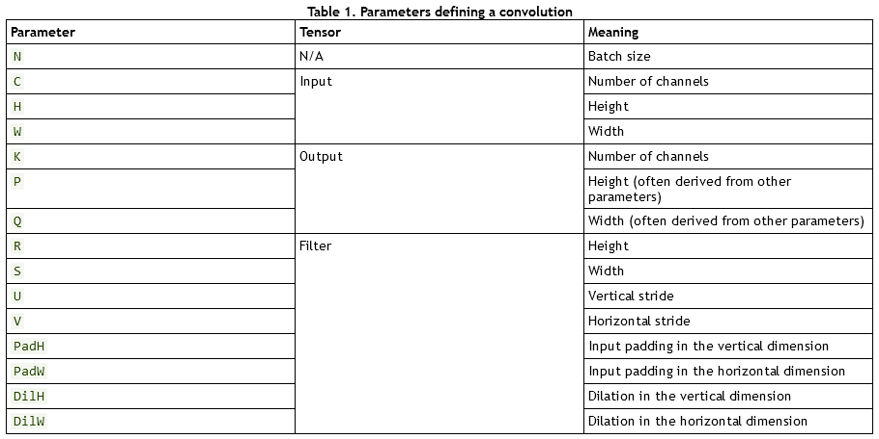
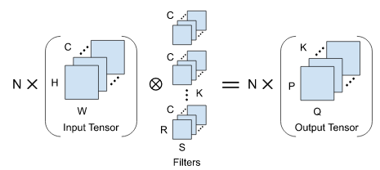
Terms and parameters of Deep Learning

